Slide 1
Student Housing Management System
Project Members:
1. Rudro Rifat Al Mamun 19-39909-1
2. Tamhid Mostafa Ansari 18-39142-3
3. Sumit Chandra Shovon 18-37115-3
4. Khadiza Begum Himu 18-38904-3

Slide 2
Introduction:
Student and Householder face problem when they meet for renting house
Student and Householder is the main user .
Householder will give facility to students.
Student will get a Hassle free living space

Slide 3
Why Student
Major part of national resource.
Budget
Shifting problem.
Security.
Saving time.

Slide 4
Objective and Goals
Major Part: Student can rent place easily.
Will connect both landlord and students.
Make a platform for student to rent house Easily
Ensure continuous service to both Landlord and Student.

Slide 5
Existing Solutions and Lackings
Existing Solution:
Bproperty
Bikroy.com
Housetoletbd
What they don’t have:
Not work with only Student.
No continuous Service.

Slide 6
What we proposed
House rent service For Student.
Ensure Security about student to Landlord.
Continous service for both user.
Feedback from both user and work on it.

Slide 7

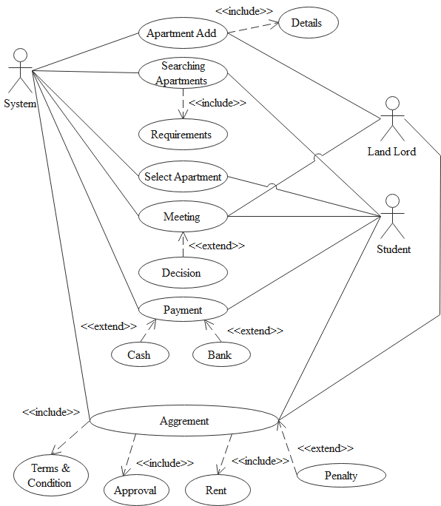



Diagram Analysis Use Case

Slide 8
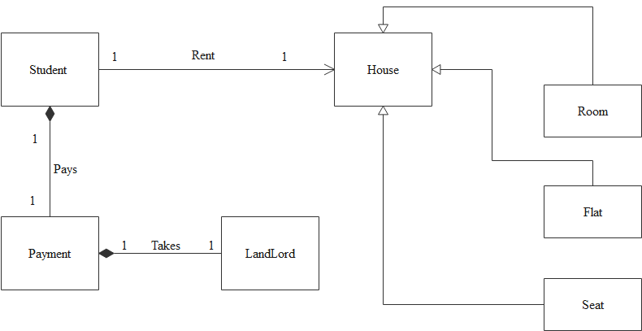
Class Diagram

Slide 9
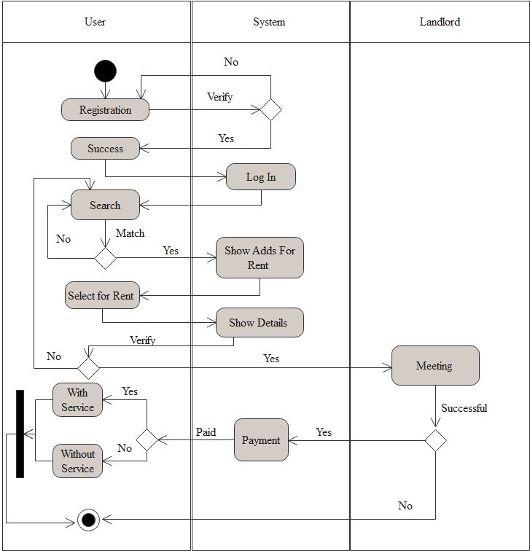
Activity Diagram

Slide 10
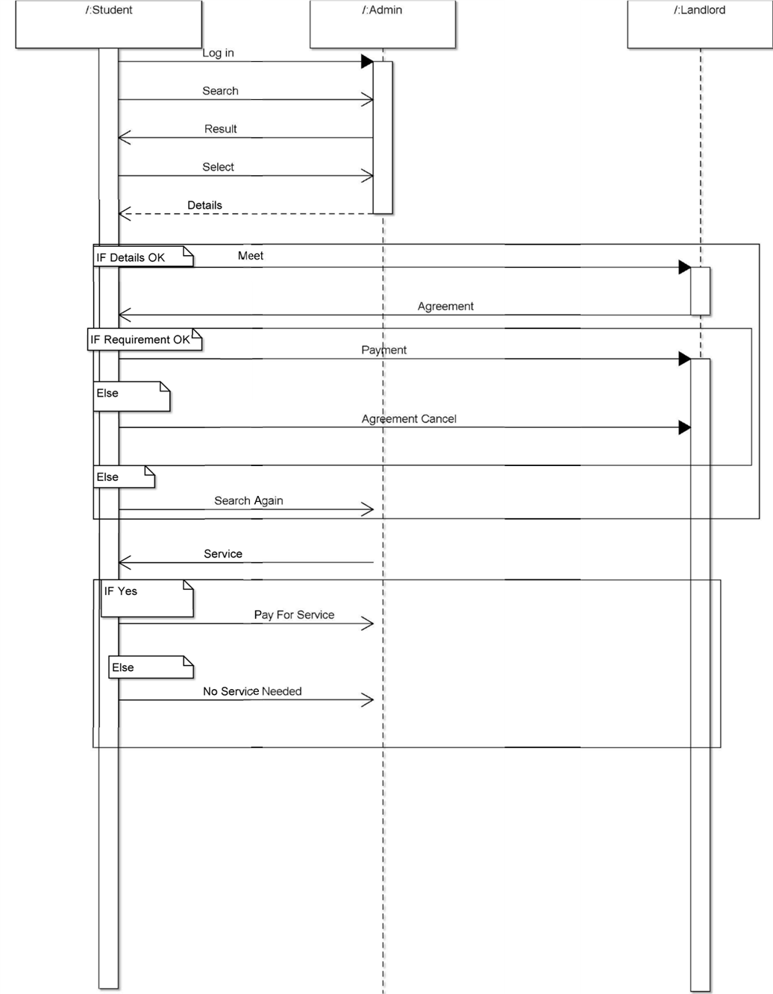
Sequence Diagram

Slide 11
Conclusion
A shortest and easy way to get house , seat and room.
Will save time.
Will give extra facilities and service.
Student can easily find a place to live without any hassle.
Will be secure enough.

